Slide 1
EXCEL CAPSTONE PROJECT ZOMATO RESTAURANT ANALYSIS

Slide 2
OVERVIEW
Following is the EXCEL CAPSTONE project on ZOMATO RESTAURANT ANALYSIS
The Excel Sheet consists of restaurants of 15 countries
Sheet consists of 9552 rows and 22 coloums
Analysis is of restaurants from various countries of their ratings and costing for 2 people
This analysis give us an overview of the best restaurants according to the countries and the cities

Slide 3
AVERAGE RATINGS ACCORDING TO COUNTRIES

Slide 4
Aggregate ratings for cities in india

Slide 5
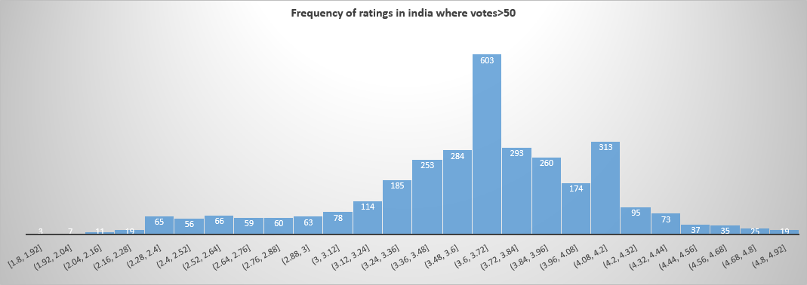
Frequency of ratings in india where votes>50

Slide 6
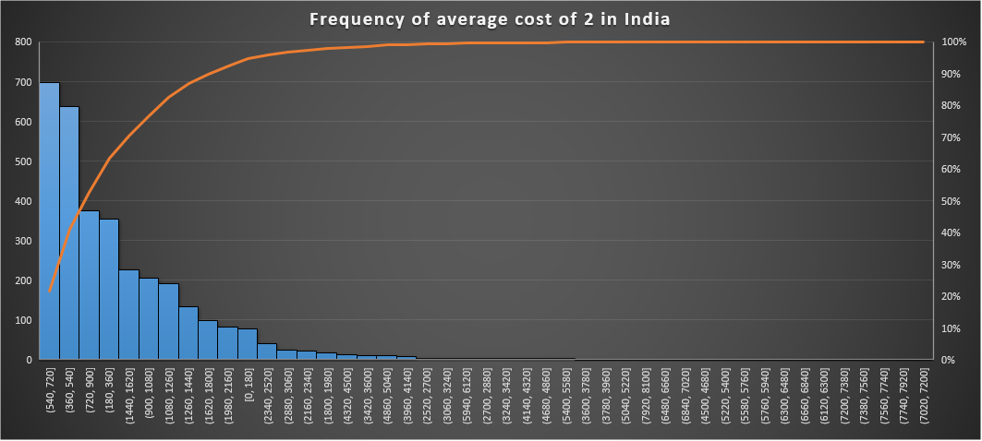
FREQUENCY OF average cost of 2 in india in rupees

Slide 7
AVERAGE COST FOR 2 FOR SOME CITIES IN INDIA

Slide 8
RATING TYPES OF RESTAURANTS
FOLLOWING IS THE PIE CHART FOR RATING-TYPES FOR VARIOUS RESTAURANTS IN INDIA.
EXCELLENT : GREATER THAN 4.5
VERY GOOD : BETWEEN 4.5 AND 4
GOOD :BETWEEN 3.5 AND 4
AVERAGE :BETWEEN 2.5 AND 3.5
POOR :BELOW 2.5

Slide 9
CHART DESCRIBING COUNT OF RESTAURANTS HAVING ONLINE TABLE BOOKING FACILITY
THIS CHART GIVES US INFORMATION ABOUT THE NUMBER OF HOTELS WHICH ALLOW TABLE BOOKING ONLINE.

Slide 10
POOR RATINGS AND AVERAGE-COST>1500

Slide 11
RATINGS>4.7 AND AVERAGE COST<500

Slide 12
COMPARISON FOR AVERAGE COST OF 2 AND RATINGS FOR CITIES IN INDIA

Slide 13
THANK YOU

